Slide 1
Water security and the right to food in climate challenged countries: women at the center
The water challenge for agriculture and food security
Brussels Development Briefing:
The water we eat:
Challenges for ACP countries in times of scarcity
April 13, 2011
iatp.org

Slide 2
Water Stress Index 2011

Slide 3
Projected changes in agricultural productivity in 2080

Slide 4
feminization of food insecurity.
Women, food security disproportionate impact
Even though they are involved in all aspects of food preparation, they are most hungry
Women make up a little over half of the world's population, but
they account for over 60 % of the world’s hungry.

Slide 5
Convergence of crises
Climate Change
Food production
Water Crisis
Our solutions need to be integrated

Slide 6
Convergence of crisis…….
Little recognition that any action initiated to address one of the crises can impact the other and that thus we have to be extremely careful about the solutions we advocate.
Our solutions need to
be integrated,
have multiple benefits
Should not negatively impact any aspect of crises

Slide 7
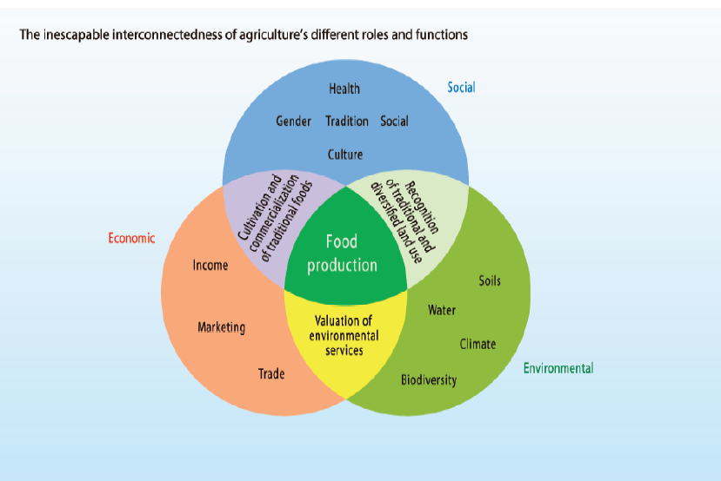
Multi-functional Agriculture…
Source: IAASTD (2008)

Slide 8
Multifunctional agriculture
food production at the core
feed, fibers, medicinal plants,
rural energy sources,
environmental services (water quality, water retention), landscape amenities,
Intangible: social, religious and cultural relevance of agricultural practices for community viability

Slide 9
Tamil Nadu Women’s Collective Areas in India

Slide 10
Tamilnadu Women’s Collective, India,
Apex body with 38 member collectives
150,000 members
Women from lowest castes
Caste based and gender based violence
Land struggles, and other struggles around resources
Practices towards food security, water security
Savings and credit with a focus on socio-cultural and ecological needs
Policy advocacy
Source: Women at the Center of Climate Friendly Agriculture and Water Use

Slide 11
Convergence of crises……….
…… most acutely felt by marginal communities , who depend on local natural resources for their livelihood security and water security,
such as members of Women’s Collective in Tamil Nadu, and similar communities in other states of India, or for that matter,
Rural communities in almost all ACP countries

Slide 12
WC focus : Violence Against Women

Slide 13
Food security and violence against women
“Initially we were analysing all the issues as violating the right of the women and addressing the issues; in the same line the issue of land rights was analysed as violating the economic and livelihood rights of the women.”
-Sheelu, Chennai, October 2010

Slide 14
Their approach to food and water security…. informed by the following principles. ..
Empowerment of women as political actors in the society and as co-decision makers at household level
participation in Democratic Local Governance Systems
Promotion of multifunctional agriculture

Slide 15
Policy interventions directed towards food and water security
Strengthening
local food systems
Rebuilding the
natural resource base
a. Focus on millets as a culturally, nutritionally and environmentally appropriate crop
b. Reforming food distribution systems to support local agriculture
a. Transitioning to “natural farming” methods
b. Focus on water conservation: water harvesting, system of rice intensification
c. Focus on water quality: protection from agro- chemical pollution

Slide 16
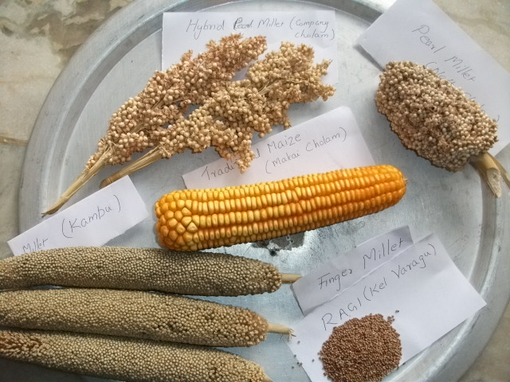
Focus on millets as a culturally, nutritionally and environmentally appropriate crop

Slide 17
Reforming food distribution systems to support local agriculture:
Ag, Food and Trade policy change advocacy around
Millet cultivation
Local food reserves
Food aid policy to support local sourcing/ food produced through natural farming
Local Economic / Resource mobilization

Slide 18
Natural farming as distinct from organic farming

Slide 19
Focus on water conservation: water harvesting, Low water use agriculture, system of rice intensification (SRI)

Slide 20
WC on New initiatives on food security
The “new” green revolution
address one aspect of water crisis, that too partially: over-irrigation, and depletion;
fails to recognize the multiple means available for achieving food security;
continues to undermine an agriculture can provide local food security for marginal groups;
ignores the imperative of having to move away from an industrial agricultural systems to deal with climate crisis
ignores agro-ecological approaches (responsive to the needs of marginal groups, and that help contribute to viable rural communities through its multiple functions).

Slide 21
Most interesting aspects of women’s Collective’s work on food and water security:
Women have trusted their traditional knowledge, but have also built on it, to enhance productivity and sustainability
by selectively and carefully reintroducing both traditional and modern practices.
From the perspective of climate change policy, their interventions are synergistic, bringing together an “adaptation strategy” and a “mitigation strategy.”
that is rooted in women’s empowerment, ecological integrity and economic viability

Slide 22
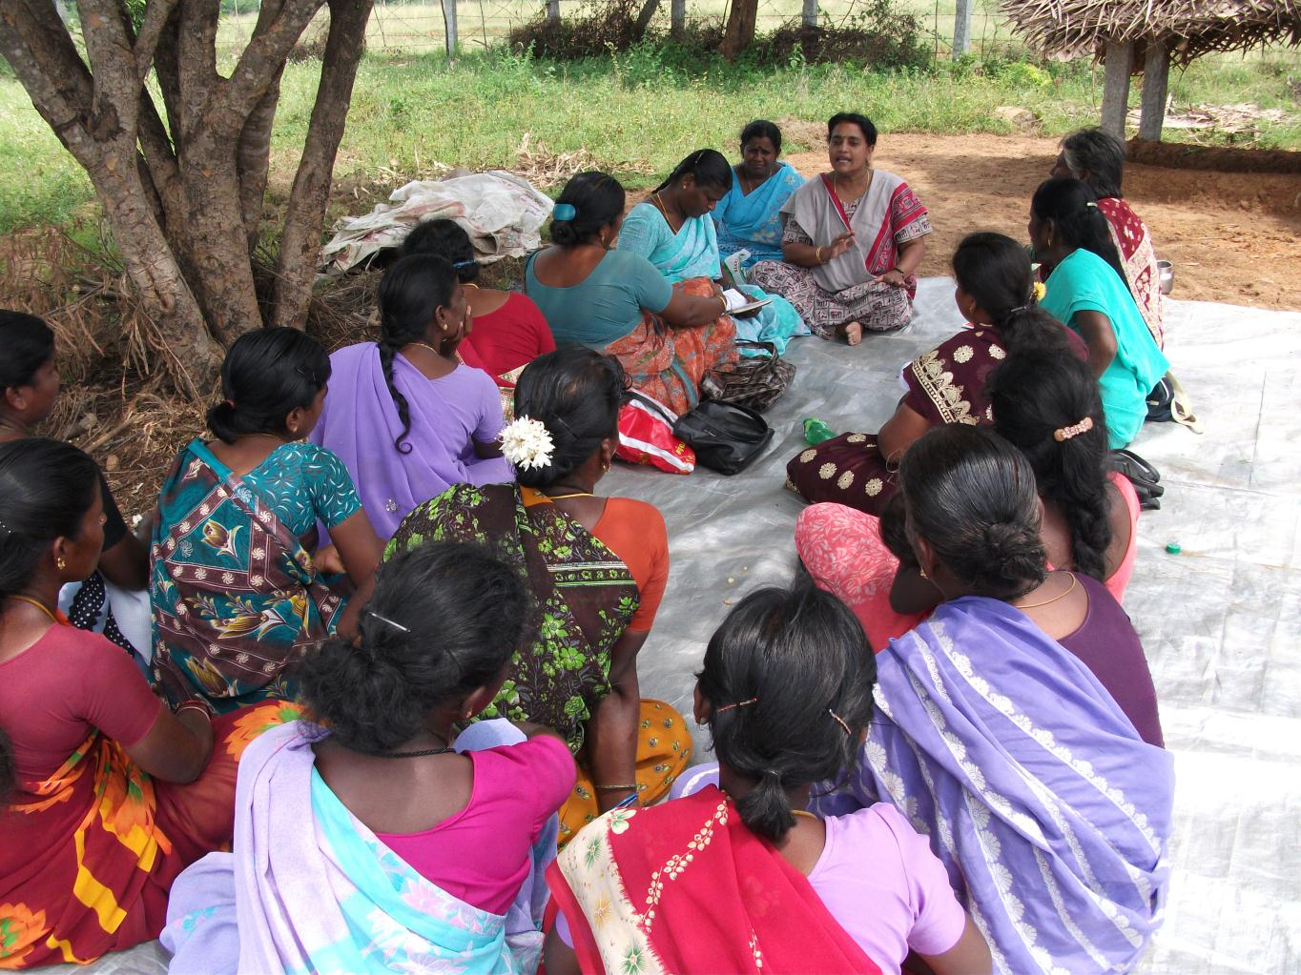

Slide 23
Thank You!

